Slide 1
[1]: Title
‘Shop Manager’
Shop management game focused on AI, developed in Unity3D
Project Student: James Jamieson
Supervisors: Alain Simons and Feng Tian
Project Presentation 1 – December 2016

Slide 2
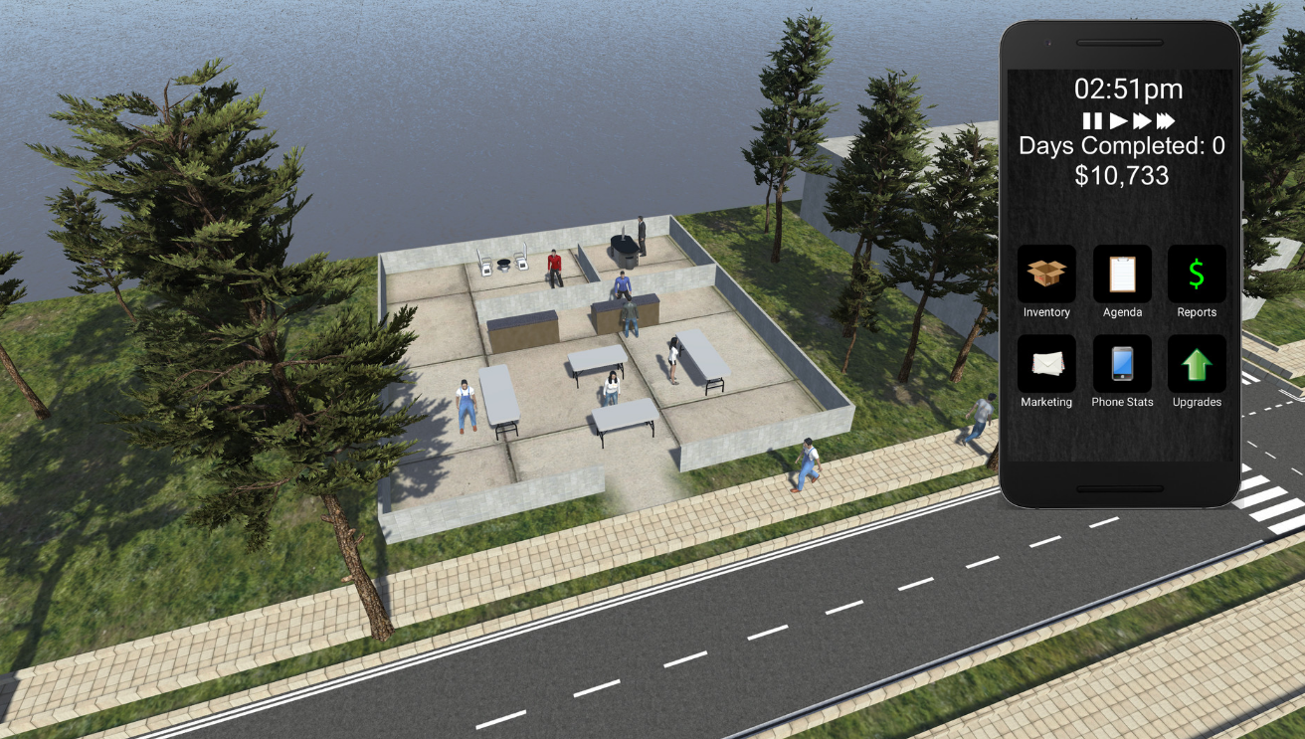
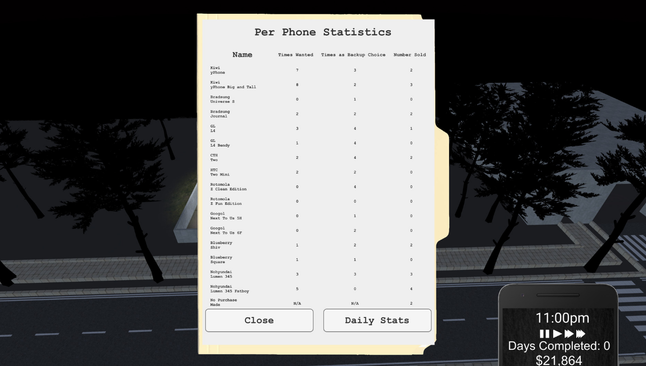
[2]: Project Summary
Customers Service Assistants (CSAs) and managers have very different jobs roles.
There currently lacks a system, or training simulator, that helps workers make the jump if they get a promotion and need to jump into the new role quickly.
There are currently very little shop management games, or training simulators available for public use.
Those that are available are very simplistic in their AI capabilities and are hard to navigate and use.
This project is designed to develop a game/simulator that emulates the shop environment and allows people to experience a realistic example of shop management.
The program will hopefully allow people to use it for educational reasons, but also be enjoyable enough to play in their free-time, to develop key skills such as time and money management.
Figures [1] and [2] – Example of a game management mobile game.

Slide 3

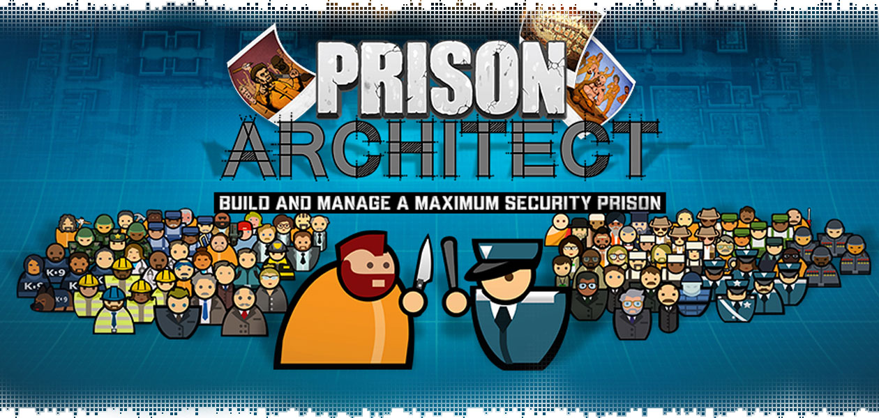
[3]: Background
Idea came from boredom and thinking about how to spend my free time.
I am a CSA at a Co-Operative store and I know the ins and outs of daily operations.
I know what it is like to be an employee at the lowest level.
Research was done by looking at games similar to the one I want to create.
RimWorld and Prison Architect were my main inspirations.
After initial coding, the game looked successful and I decided to use it for my project.
I decided to strip the game back to include AI but none of the other advanced features.
Figure [3]– RimWorld title screen.
Figure [4]– Prison Architect title screen.

Slide 4
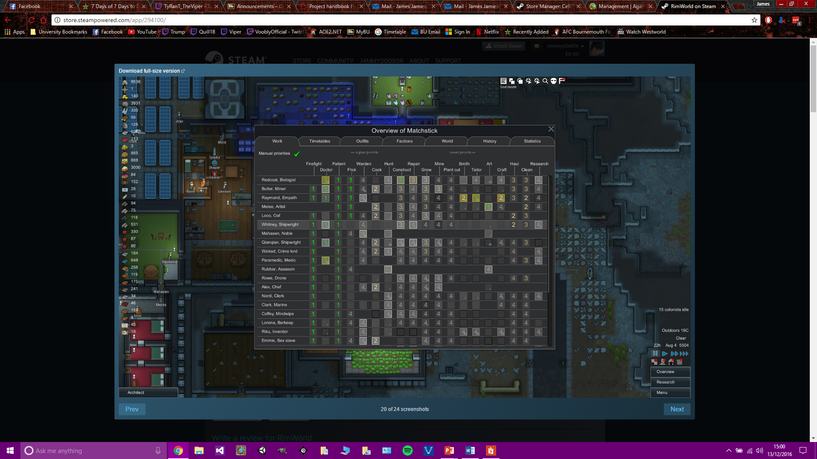
[4]: Aims and Objectives
Aims:
To have a program that realistically simulates a shop environment that people can use to learn and develop essential skills for jobs in this environment.
Objectives:
Research and evaluate tile-based game design and AI concepts and literature.
Evaluate already existing management games, and games with advanced AI.
Develop a sophisticated AI capable of correct job decision making and customer satisfaction.
In-depth testing to examine AI capabilities and correct errors and unforeseen problems.
Release near-finished build to public for feedback.
Evaluate responses and adjust AI and other game mechanics accordingly.
Figure [5]– RimWorld job assignment system
People experiences in a shop environment.
People not experienced in a shop environment.

Slide 5
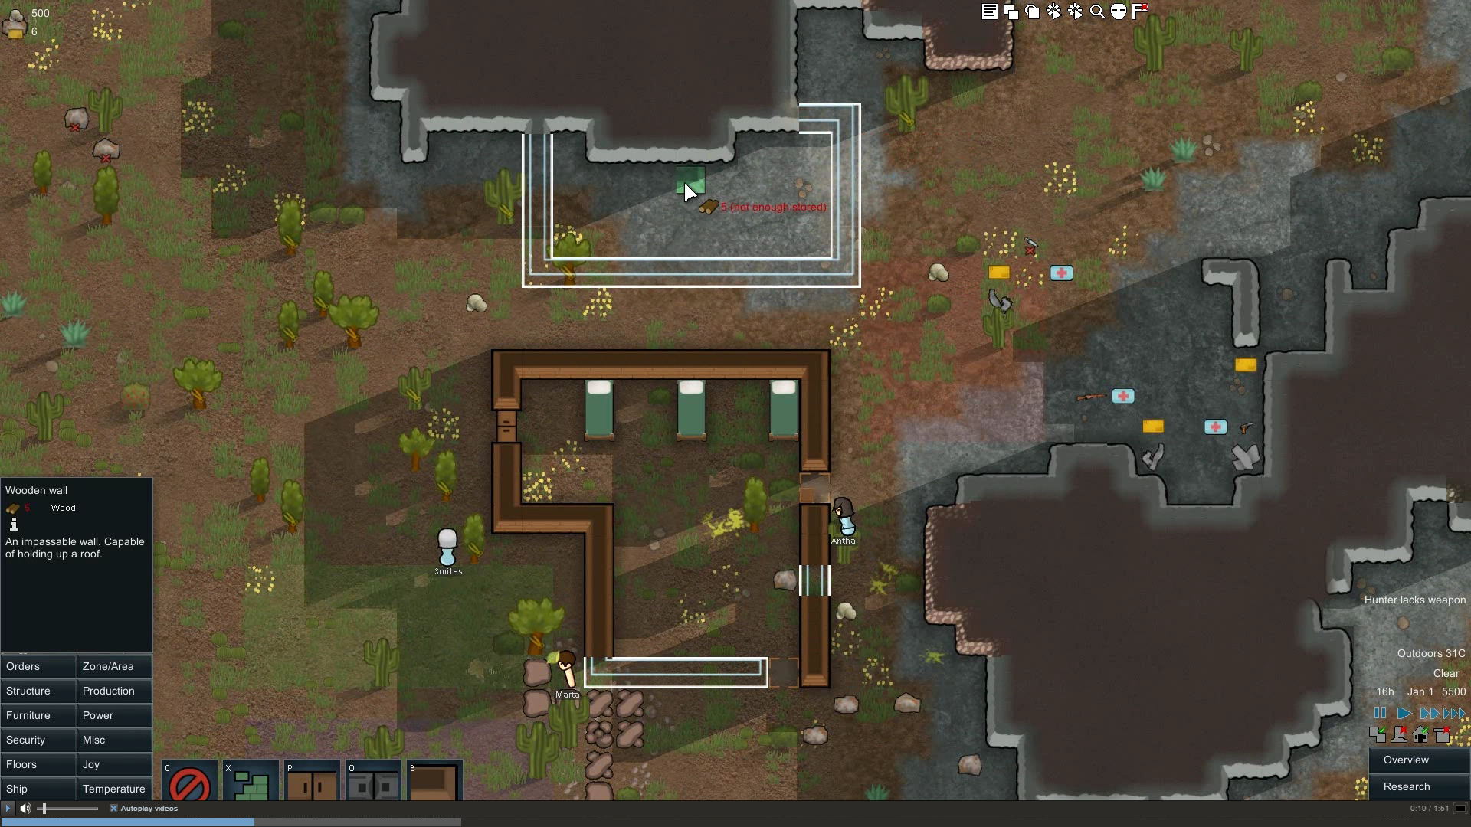
[5]: Case Study: RimWorld Job System
RimWorld has a rich and sophisticated job system.
Different characters have different skills and are better at certain jobs, and some character cannot do certain jobs.
This means that thought must go into what jobs certain characters need to do and what jobs some characters shouldn’t do.
The process of choosing what job a character does is automatic, and all jobs can have different priorities for different characters.
Figure [5]– RimWorld job assignment system
When a character goes idle, they search for a job to complete based upon the priority of the jobs. Once a job is found they go about completing it by following certain criteria.
They begin by collecting the resources for the job, and then bring them to the job site, this is repeated until the job can be performed, at which time they begin the work.
All jobs require a job time, and a character must keep doing the job until the time is completed.
In contrast to my game, the characters have a lot of building jobs and fighting jobs, whereas the characters in my game are simply going to be collecting stock and moving it around the shop. This means that only a small amount of my jobs are going to be standing at the same place for a long period of time.
Figure [6]– RimWorld characters completing jobs

Slide 6
[5.1]: Case Study: RimWorld Job System
RimWorld has a rich and sophisticated job system.
Different characters have different skills and are better at certain jobs, and some character cannot do certain jobs.
This means that thought must go into what jobs certain characters need to do and what jobs some characters shouldn’t do.
The process of choosing what job a character does is automatic, and all jobs can have different priorities for different characters.
Figure [5]– RimWorld job assignment system

Slide 7
[5.2]: Case Study: RimWorld Job System
When a character goes idle, they search for a job to complete based upon the priority of the jobs. Once a job is found they go about completing it by following certain criteria.
They begin by collecting the resources for the job, and then bring them to the job site, this is repeated until the job can be performed, at which time they begin the work.
All jobs require a job time, and a character must keep doing the job until the time is completed.
Figure [6]– RimWorld characters completing jobs

Slide 8
[5]: Case Study: RimWorld Job System
RimWorld has a rich and sophisticated job system.
Different characters have different skills and are better at certain jobs, and some character cannot do certain jobs.
This means that thought must go into what jobs certain characters need to do and what jobs some characters shouldn’t do.
The process of choosing what job a character does is automatic, and all jobs can have different priorities for different characters.
Figure [5]– RimWorld job assignment system
When a character goes idle, they search for a job to complete based upon the priority of the jobs. Once a job is found they go about completing it by following certain criteria.
They begin by collecting the resources for the job, and then bring them to the job site, this is repeated until the job can be performed, at which time they begin the work.
All jobs require a job time, and a character must keep doing the job until the time is completed.
In contrast to my game, the characters have a lot of building jobs and fighting jobs, whereas the characters in my game are simply going to be collecting stock and moving it around the shop. This means that only a small amount of my jobs are going to be standing at the same place for a long period of time.
Figure [6]– RimWorld characters completing jobs

Slide 9
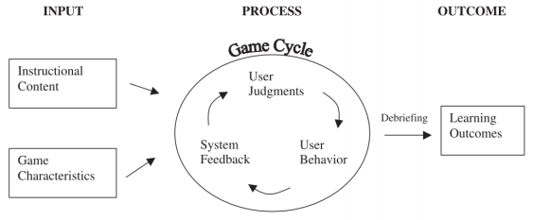
[6]: Case Study: Learning Simulation Game Development
Reference: Salmi (2015)
A thesis on using virtual simulations as a main source of learning and the development behind simulation programs and games.
“A main way of learning is by doing, however, if someone who isn’t experienced finds themselves with any kind of power, then things could go wrong. Virtual simulations are a great way of learning through doing, but without any risk of real-life disasters.”
Chapter 4 – it explains about learning simulation games and game-based learning.
It lists criteria for successful game creation that keeps players engaged, and how this can be linked with challenges that improve the players skills
This is the aim of simulation games – and in turn the game to be created for this project.
Garris et al. (2002) introduce the Input-Process-Outcome Game Model (Figure [6]). It emphasizes that people learn from active engagement with the environment, this experience coupled with instructional support of debriefing can provide an effective learning environment.
The input represents the game itself.
The process represents the game session.
The learning outcomes is the reason for the simulation.
The debriefing is important and ensures that the player learns the insights of the simulation model, otherwise the player will not be able to link what they learn back to real-life situations.
Figure [7]– Input-Process-Outcome Game Model

Slide 10

[7]: Case Studies Summary
Case studies: main focus points of the project.
They will be used in conjunction with each other to develop something that is fun and also educational.
Other studies will be looked at for other topics throughout the project such as pathfinding.
Figure [8]– Learning Simulation Game Development.
Figure [3]– RimWorld title screen.

Slide 11
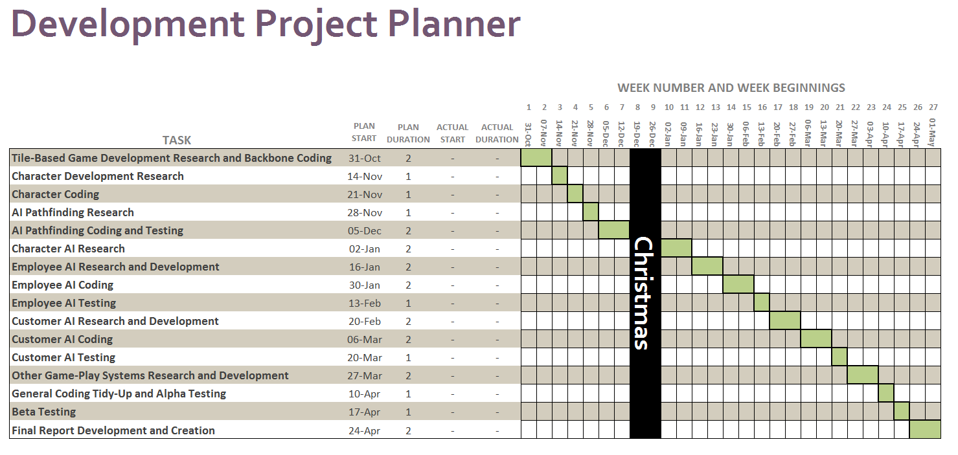
[8]: Project Planning
Completed AI pathfinding.
After Christmas, work begins on character AI research.
Risks:
Not much room for problems or unforeseen issues.
1 week for beta testing may not be enough due to sending out the program and getting the results back.

Slide 12
[9]: References
Salmi, J., 2015. Learning Simulation Game Development [online]. Thesis (Master’s). Aalto University
Figures:
[1] and [2] – 2015. N/A [Screenshot]. N/A: ChiVue Games. Available from: http://store.steampowered.com/app/420910/ [Accessed Dec 2016]
[3] – 2016. N/A [Image]. N/A: Ludeon Studios. Available from http://cdn.akamai.steamstatic.com/steam/apps/2032054/movie.293x165.jpg?t=1464212072 [Accessed Dec 2016]
[4] – Pogue, C., 2016. N/A [Image]. USA: geeksundergrace.com. Available from http://www.geeksundergrace.com/wp-content/uploads/2016/05/logo-prison-architect-.jpg [Accessed Dec 2016]
[5] – 2016. N/A [Image]. N/A: Ludeon Studios. Available from http://cdn.akamai.steamstatic.com/steam/apps/2032054/movie.293x165.jpg?t=1464212072 [Accessed Dec 2016]
[6] – 2016. N/A [Image]. N/A: Ludeon Studios. Available from http://cdn.akamai.steamstatic.com/steam/apps/2032054/movie.293x165.jpg?t=1464212072 [Accessed Dec 2016]
[7] and [8] – Salmi, J., 2015. Learning Simulation Game Development [online]. Thesis (Master’s). Aalto University

Slide 13
Any Questions?

